Slide 1
Update for growers in the Horizons region
18th September 2024

Slide 2
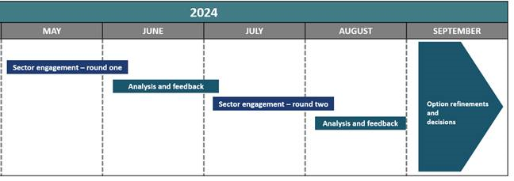
Freshwater Farm Plans Background
Under the existing regulations, Horizons went live on the 1st April 2024 in a staged approach.
There has been consistent messaging from the government that FWFP’s are a useful tool but they intend to improve the system.
Consultation involved variety of industries including: councils, farmers and growers and iwi.
September 4th 2024, the announcement was made that there will be a pause in the roll-out of FWFP’s until system improvements are finalised.
The pause will be enabled through minor amendments to the Resource Management Act (RMA). Farmers/growers wont be required to submit a farm plan for certification while changes are made to the system.

Slide 3
Freshwater farm plans
Background
While Horizons has acknowledged the pause, there is still uncertainty.
New system improvements (NOT yet implemented or confirmed)
Risk based plans: complexity and actions could reflect the risk of contaminant loss
Combining certifier and auditor roles to reduce cost
Audit timeframes: risk perspective

Slide 4
Freshwater Farm Plans What have we been working on the last few months?
Completed our regional training and it went live
Eight web-based training modules were available for potential certifiers/assessors
Number of applicants completed the training
Pdf of modules for public availability
CCCV’s further improvements and changes have been made. Live FMU’s have CCCV’s available on our website. See the FWFP tile on the front page of our website.
Developed our website. Links to guides to different sectors developing FWFP’s are available, as well as useful information for mapping farms and how to use the CCCV.
Light touch approach: encouraging farmers to think about a plan. Their efforts now will still remain valid in an updated system. However, most farmers were waiting until they have greater certainty about system changes.
Provided support to catchment groups and industry groups.

Slide 5
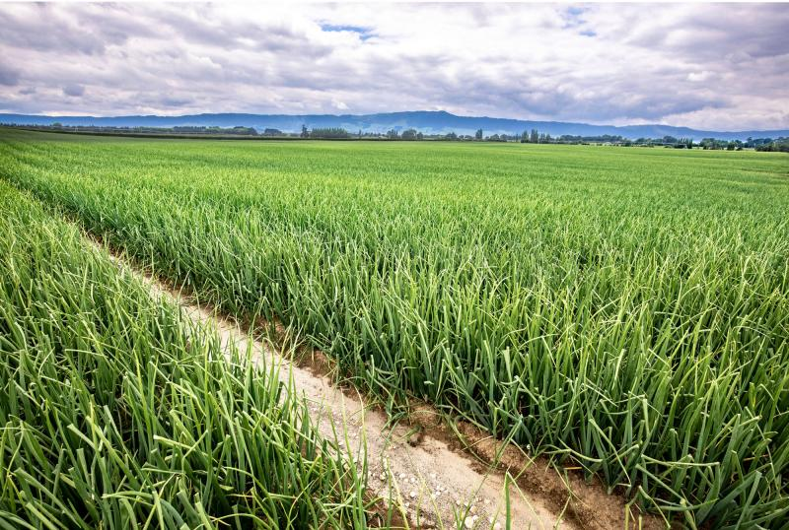
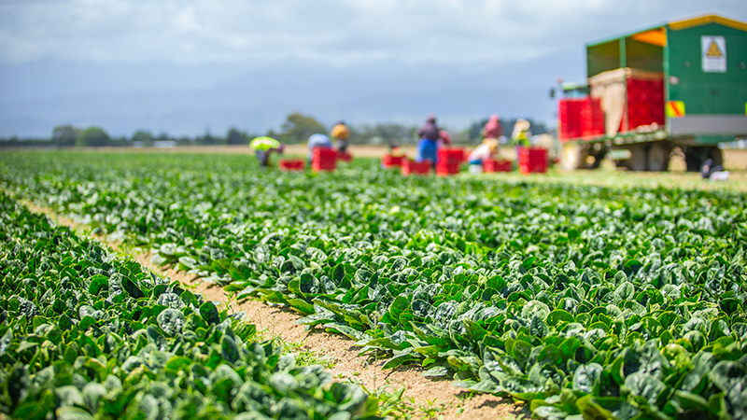
Freshwater Farm Plans What is Horizons doing now?
Uncertainty around our next steps as a council. We are awaiting further announcements regarding the pause.
We have paused our regional training and applications in the meantime.
Continue to work on areas of FWFP behind the scenes
CCCV’s
Regional training – workshops

Slide 6
Oranga Wai | Our Freshwater Future
Freshwater One Plan review
Council resolved to delay notification until late 2026/early 2027
This gives us time to do more community, tangata whenua and industry engagement, and gather more evidence
It also means that we can respond to the replacement NPS-FM (should be in force mid-2025)
Council’s desire to stop any decline in freshwater health and see improvements in water quality remains

Slide 7
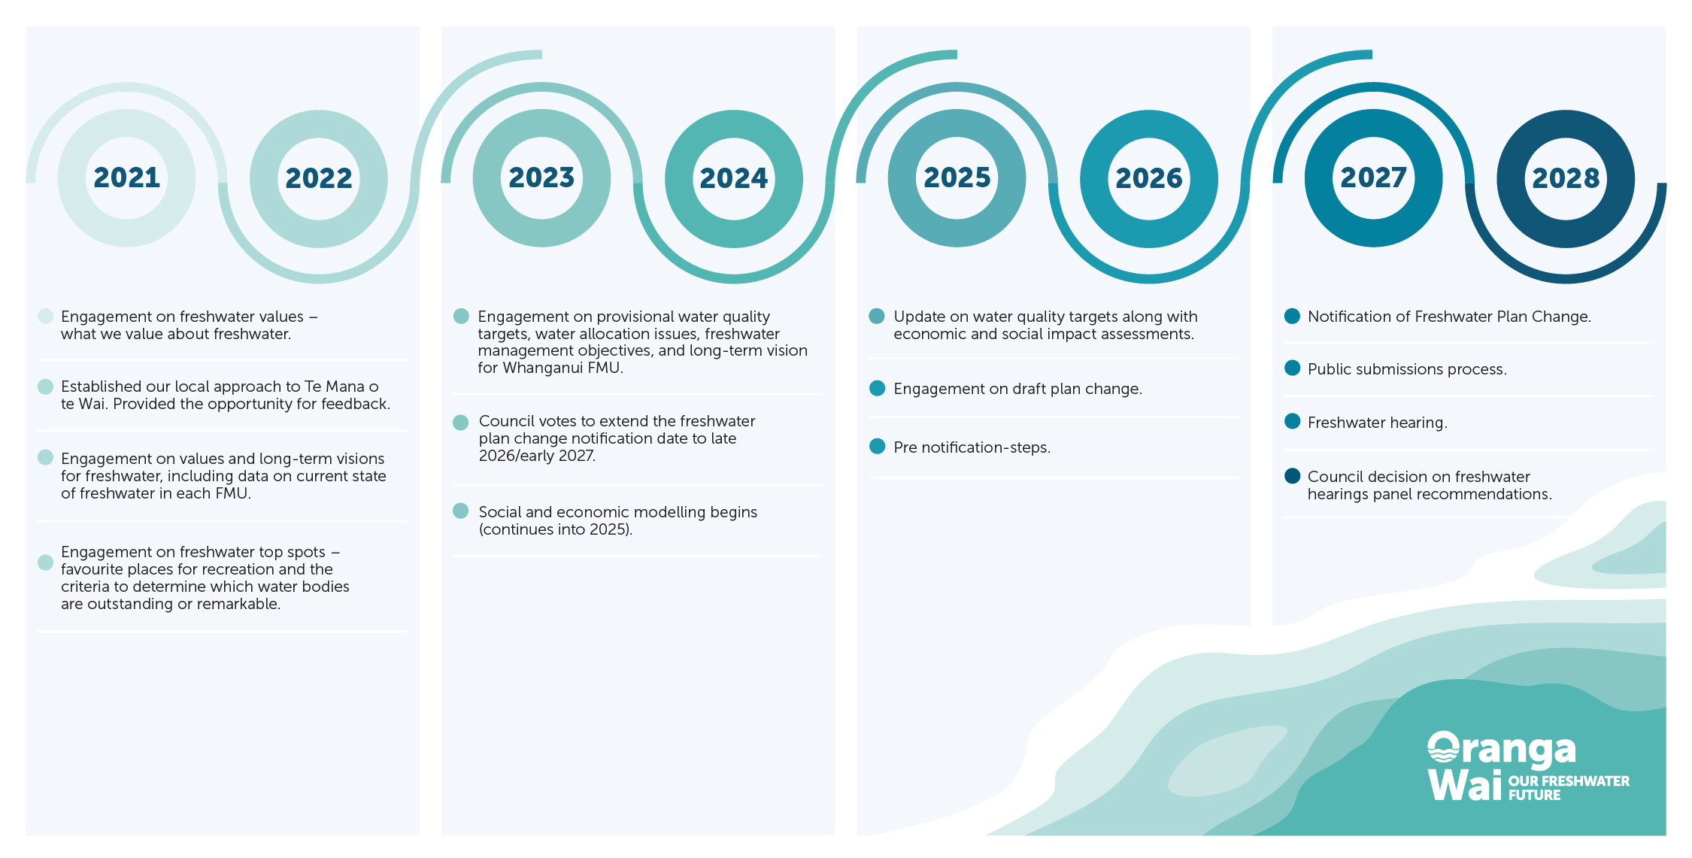
NPS-FM replaced

Slide 8
Oranga Wai | Our Freshwater Future
What are we doing now?
Continuing economic analysis
Reviewing One Plan river, lake and estuary water quality targets
Technical work to develop environmental flows and take limits for rivers (water quantity)
Beginning drafting of the plan change
Waiting for direction on Plan Change 2
Quashing of the Horowhenua specified vegetable growing area
What will Horizons do to provide for CVG? We can’t answer that yet. Depends in part on PC2, and the Govt’s RM reform work.

